Slide 1
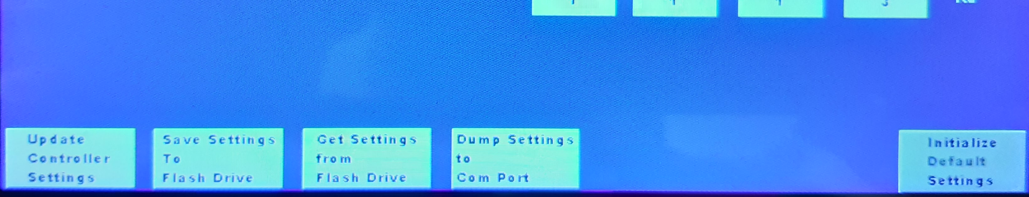
block diagram of the e_mc²
Normal operation
handling of screen output
controller data to PC
controller data display on screen
PID controllers
Set Up
handling of settings
store to flash
retrieve from flash
transfer from Nextion
transfer to PC
change settings before transferring
flash memory
store for current approved settings
1
2
V output
1
esp32
runs PID controllers
handles display
handles settings info
PC
(Com port, log file)
4
sensor input
3
2
Nextion
Display of data
Control of ESP data exchange to COM and flash drive (1-4)
Screen input of settings (5)
part of the settings-screen
5
3
1
2
4
2

Slide 2
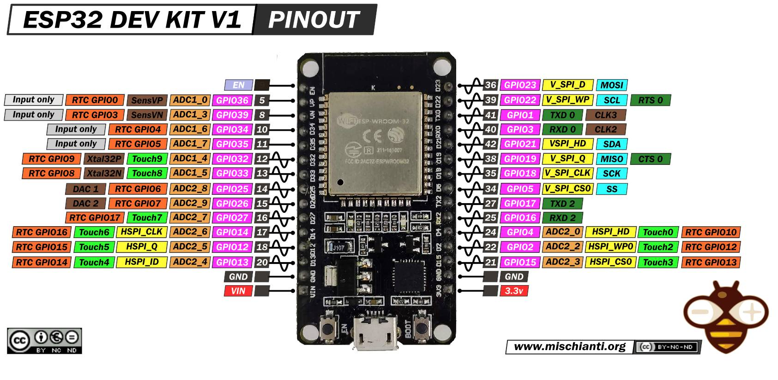
2uF
3.3V
HYT271
T / Humid
R4k7
R4k7
SCL
(used for usb)
(Temp software PWM)
(used for usb)
SDA
R2k2
(Temp analog out)
GND
R2k2
(CO₂ analog out)
MH-Z16
CO₂
R2k2
TXD/RXD
R2k2
(Humid analog out)
5V
(GPIO18, 19)
(Obj T analog out)
GND
GND
Nextion
TXD/RXD
(GPIO16, 17)
GND
5V external
apart!

Slide 3
24V
5V
~1
SSR 230V 2A/
12V 3V trigger TEMP
12V
GND
MosFet 24V 30A opto TEMP
~1
GND
Out+
GND
~2
S 1(>2V)
3.3V
HYT271
T / Humid
Out -
~2
S 2(>2V)
S (>2V)
R4k7
R4k7
SCL
CO2 tube servo
5V
GND
SDA
GND
MH-Z16
CO₂
TXD/RXD
5V
(GPIO18, 19)
GND
2uF
Nextion
(used for usb)
TXD/RXD
(used for usb)
GND
(GPIO16, 17)
R2k2
(Temp software PWM)
R2k2
(Temp analog out)
5V external
apart!
R2k2
(CO₂ analog out)
R2k2
(Humid analog out)
(Obj T analog out)
DS18B20
T Lens
GND
3.3V
R4k7
24V
MosFet 24V 30A opto LENS
5V
GND
GND
GND
Out+
Out -
S (>2V)

Slide 4
SSR 12V +
12V 1A
7805
5V Nextion
7805
5V ESP32&Relais
100uF
100uF
100uF
100uF
GND
alternative:
Coil & diode; to relais 5V +
mt3608 step-up
100uF
5V esp32
5V 2A
12V SSR
5V Nextion
100uF
100uF
GND

